Slide 1
SMS Spam detection
Sai Teja Avadhootha
YT41135

Slide 2
Introduction
Spam or unsolicited bulk messages are sent out by companies, scammers, and other malicious actors for various purposes.
Identifying and discarding these frequently taking up space in communication mediums like SMS is necessary.
Machine Learning algorithms can help in this task by evaluating incoming messages for certain patterns and likelihood of being spam.
Traditional methods like content based filtering and headers inspection have inefficiencies. The words used in content can change, therefore ML algorithms like SVM, Decision Tree, MLP Classifier, Random Forest, AdaBoost are used to classify more accurately and quickly.

Slide 3
Motivation
As the sms service is getting cheaper, the usage of sms has been increasing rapidly. Almost all parts of the world are able to use the sms service. This made sms a great medium for spammers to exploit.
As days goes by and usage of SMS service increases, the spam messages are also increasing on the network. Many fraudsters are exploiting this service to fool common people.
So a robust solution is required to find these spam messages and filter them. This project aims to build such robust solution.

Slide 4
Objective
The objective of this project is to try and experiment with different ML models to perform spam detection and come up with a model that can classify messages into spam and ham.

Slide 5
Dataset
The dataset used in this project is a kaggle dataset which contains combination of spam and ham messages
Link - https://www.kaggle.com/datasets/uciml/sms-spam-collection-dataset
It is of 503.66Kilo bytes and contains text messages and their label
Unit of analysis:
The unit of analysis is a single text message and 5169 such units are used

Slide 6
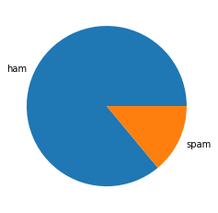
Exploratory Data analysis
In the below graph, we can see the distribution of ham and spam messages in the dataset. We can see that the data is a bit imbalance and ham messages are present more in number than spam messages.

Slide 7
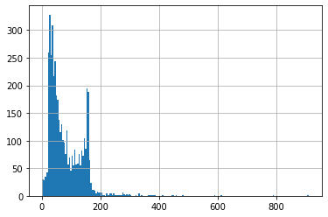
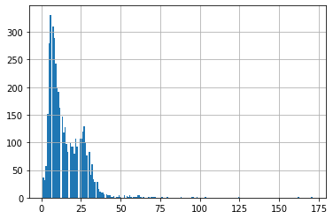
Exploratory Data analysis
In the below figure, we can see that most of the sentences are less than 200 characters or 30 words in size. So we can perform classification using simple ML models like SVM etc.

Slide 8
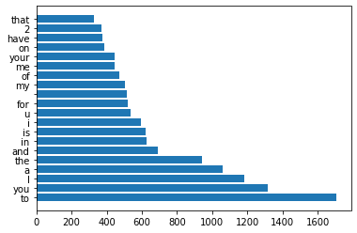
Exploratory Data Analysis
Most repeated words

Slide 9
Preprocessing
The preprocessing method used in this project is TFIDF vectorization.
TF-IDF stands for Term Frequency-Inverse Document Frequency
It is a technique used to transform text data into a numerical representation that can be processed by machine learning algorithms.
It assigns weights to each word based on how frequently it occurred in a document and in the entire corpus.
This weight can be used to perform numerical comparisons between words.

Slide 10
Models
Models are trained and analysed
Support vector machine
Decision tree
Multi layer perceptron
Random forest
Ada Boost
The confusion matrix is drawn for analysis

Slide 11
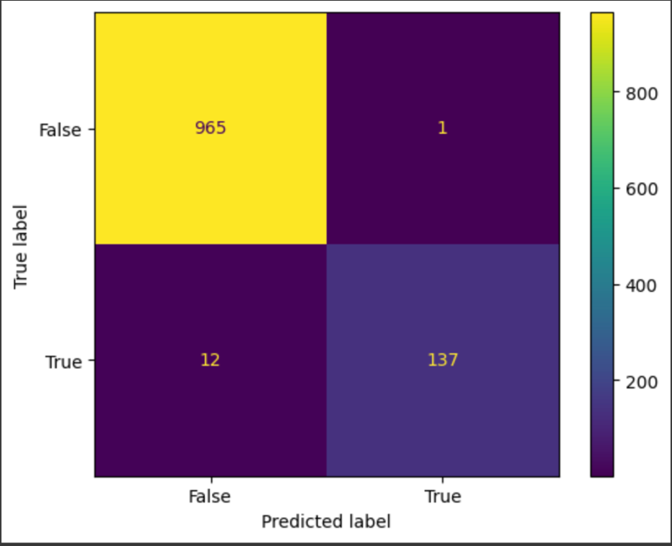
Model - SVM - confusion matrix

Slide 12
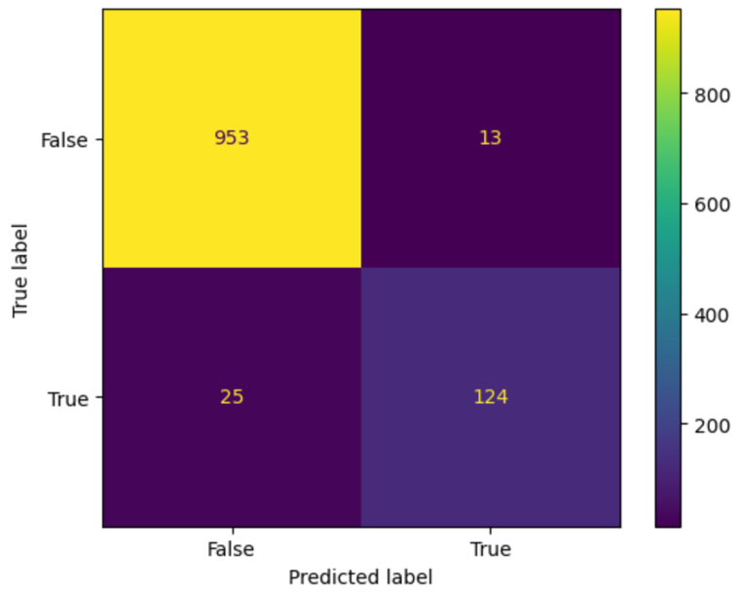
Model - Decision Tree- Confusion matrix

Slide 13
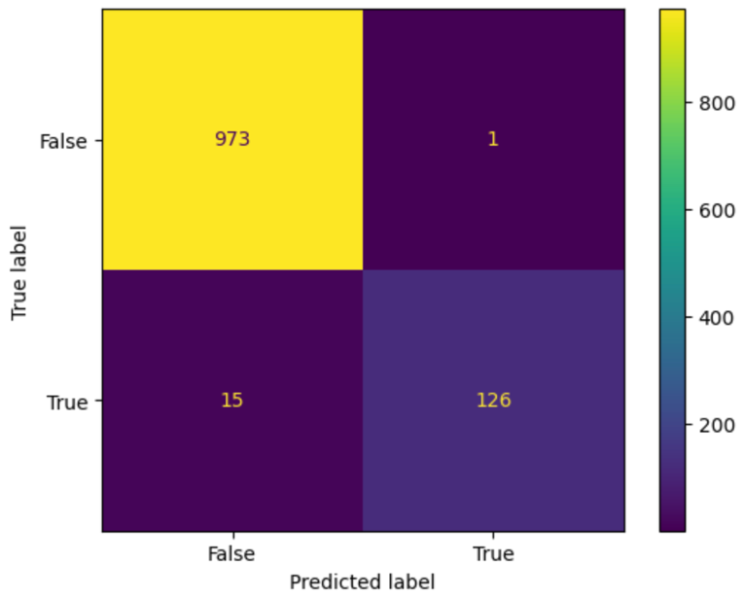
Model - MLP Classifier- Confusion matrix

Slide 14
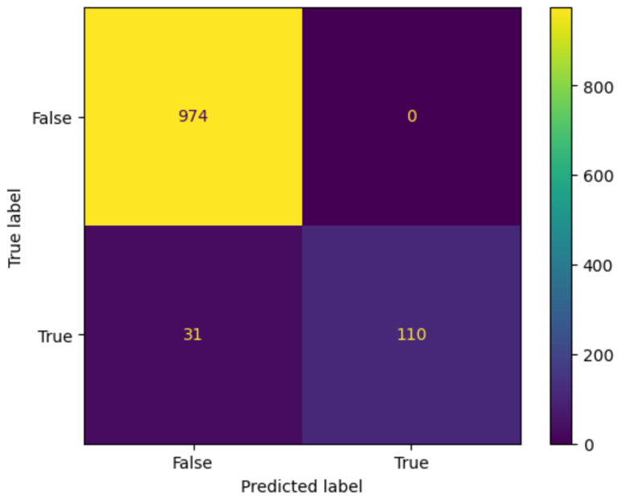
Model - Random forest- Confusion matrix

Slide 15
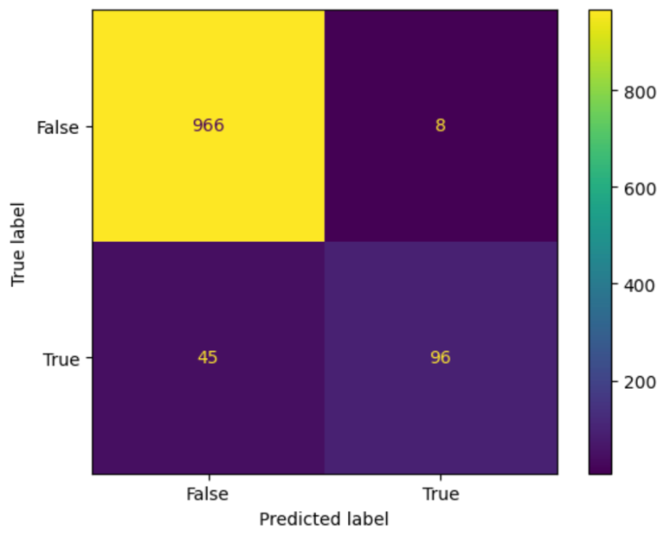
Model - AdaBoost- Confusion matrix

Slide 16
Decision
In sms spam detection, false positives are the most important concern. Moving a spam to non-spam may not cause a big trouble but moving a non-spam to spam may cause the user to miss out important information.
So we chose Random forest which had less false positives as our final model.

Slide 17
Conclusion
Using Machine Learning, spam messages from legitimate messages can be identified and classified accurately. The accuracy of the model can be further improved by fine-tuning the parameters. Moreover, this solution could be deployed in an industrial setting as it does not require any human intervention to continuously detect spam messages in real-time.

Slide 18
THANK YOU

